Slide 1
Chapter 5 Stereochemistry at Tetrahedral Centers

Slide 2
Learning Objectives
(5.1)
Enantiomers and the tetrahedral carbon
(5.2)
The reason for handedness in molecules: Chirality
(5.3)
Optical activity
(5.4)
Pasteur’s discovery of enantiomers

Slide 3
Learning Objectives
(5.5)
Sequence rules for specifying configuration
(5.6)
Diastereomers
(5.7)
Meso compounds
(5.8)
Racemic mixtures and the resolution of enantiomers

Slide 4
Learning Objectives
(5.9)
A review of isomerism
(5.10)
Chirality at nitrogen, phosphorus, and sulfur
(5.11)
Prochirality
(5.12)
Chirality in nature and chiral environments

Slide 5
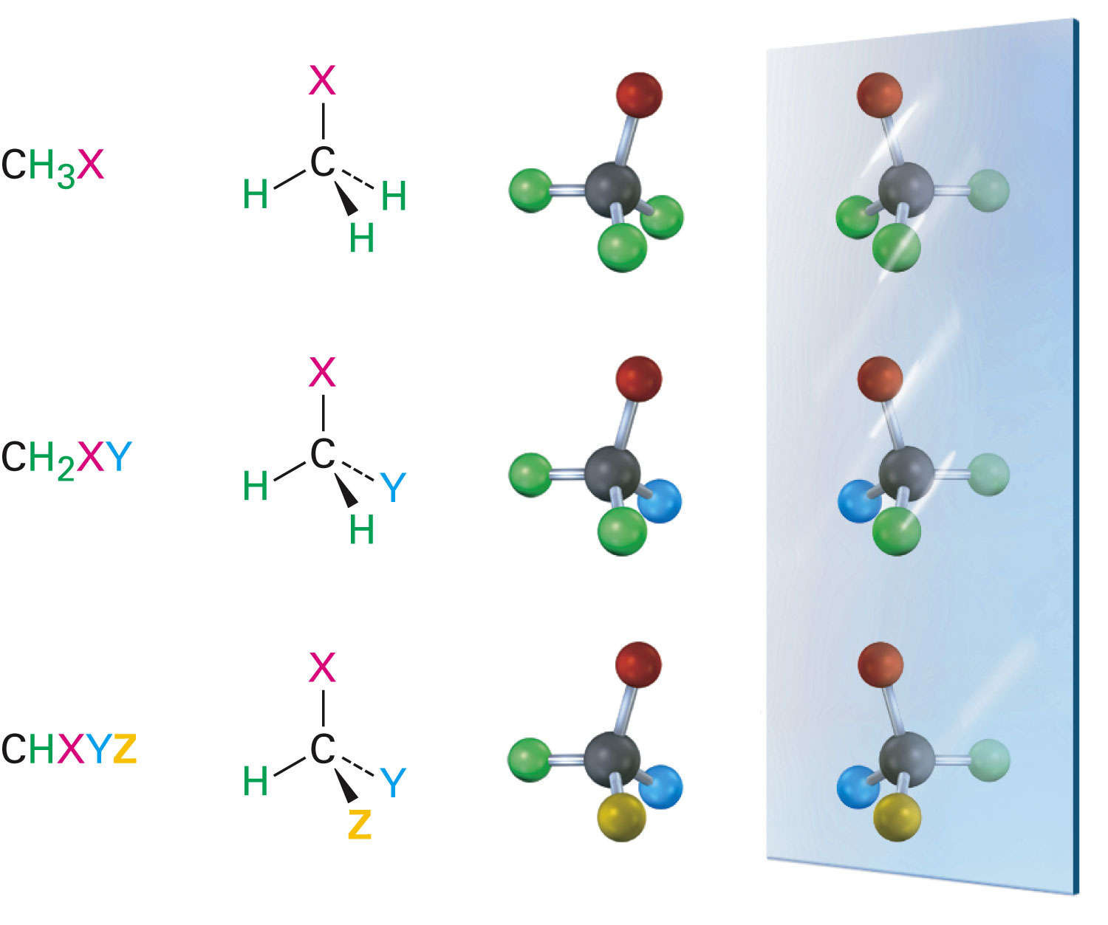
Enantiomers and the Tetrahedral Carbon
Enantiomers: Molecules that are not the same as their mirror image
A result of tetrahederal bonding to four different substituents
Notes:
Enantiomers and the tetrahedral carbon

Slide 6
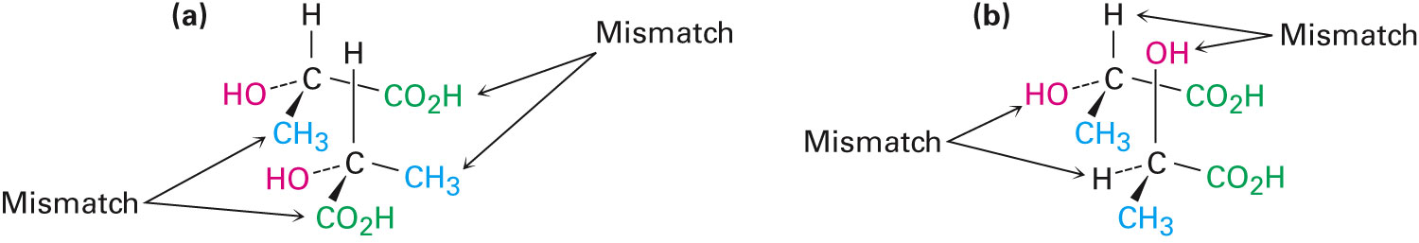
Figure 5.2 - Attempts at Superimposing the Mirror-Image Forms of Lactic Acid
Notes:
Enantiomers and the tetrahedral carbon

Slide 7
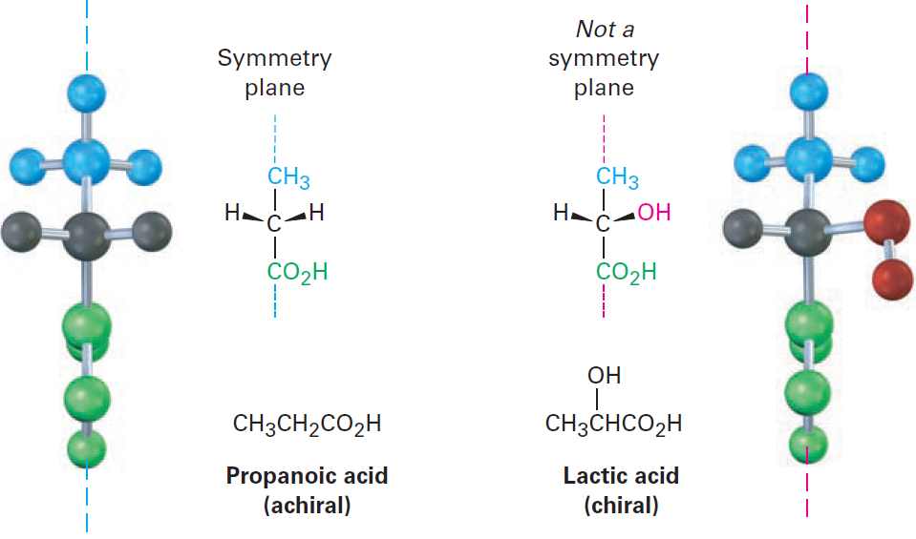
Reason for Handedness: Chirality
Chiral: Molecules that do not have a plane of symmetry and are not superimposable on their mirror image
Achiral: Molecules with a plane of symmetry that is the same as its mirror image
Notes:
The reason for handedness in molecules: Chirality

Slide 8
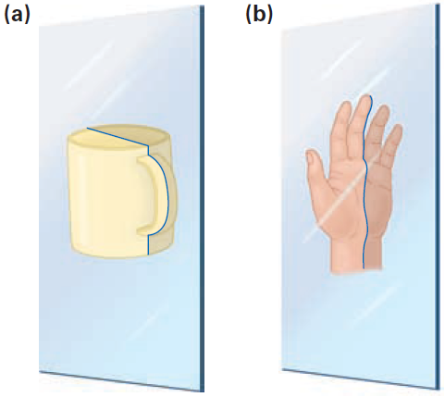
Figure 5.3 - The Meaning of Symmetry Plane
Notes:
The reason for handedness in molecules: Chirality

Slide 9
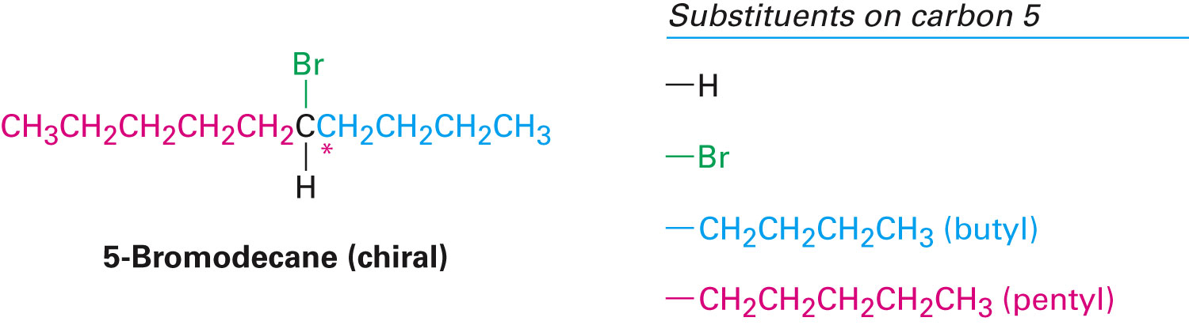
Chirality Center
Point in a molecule where four different groups are attached to carbon
Is the cause of chirality
Example
5-bromodecane has four different groups that are bonded to C5
Notes:
The reason for handedness in molecules: Chirality

Slide 10
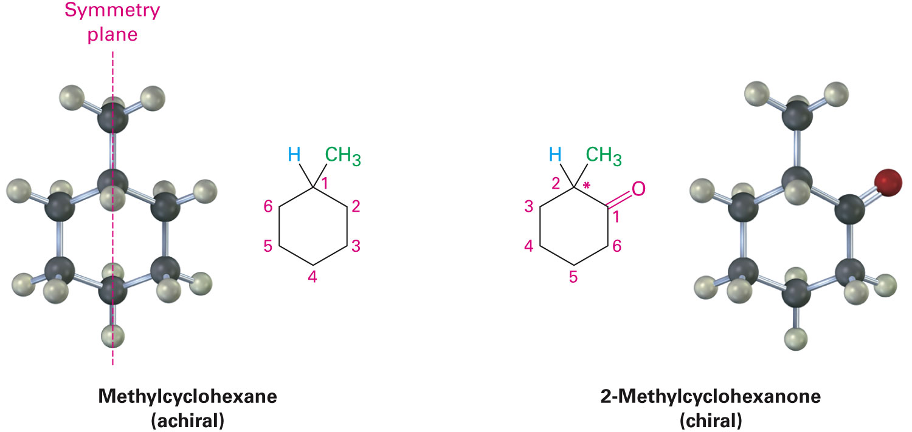
Chirality Center
2-Methylcyclohexanone does not have a symmetry plane
C2 is bonded to four different groups
Notes:
The reason for handedness in molecules: Chirality

Slide 11
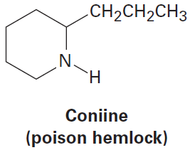
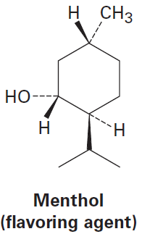
Worked Example
Which of the following molecules are chiral?
Identify the chirality center in each
a)
b)
Notes:
The reason for handedness in molecules: Chirality

Slide 12
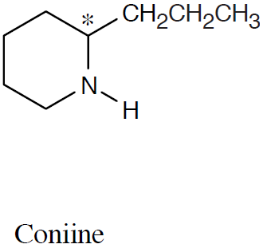
Worked Example
Solution:
All –CH₃ and –CX₃ carbons are not chirality centers
All –CH₂– and –CX₂– carbons are not chirality centers
All aromatic ring carbons are not chirality centers
a)
Notes:
The reason for handedness in molecules: Chirality

Slide 13
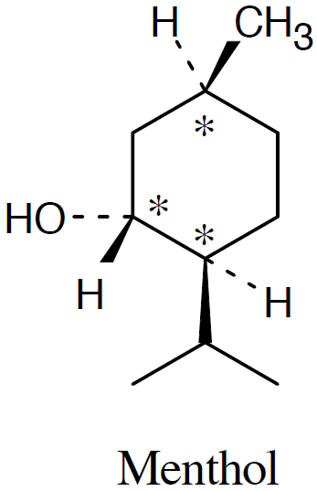
Worked Example
b)
Notes:
The reason for handedness in molecules: Chirality

Slide 14
Optical Activity
Jean-Baptiste Biot in the early 19th century investigated the nature of plane polarized light
Ordinary light consists of electromagnetic waves
Oscillate in an infinite number of planes at right angles to its direction of travel
Optically active: Property of organic compounds to rotate plane-polarized light that passes through it
Notes:
Optical activity

Slide 15
Optical Activity
Light passes through a polarizer
Polarized light is rotated in solutions of optically active compounds
Measured with polarimeter
Rotation, in degrees, α
Levorotatory: Optically active substance that rotates the plane of polarization of plane-polarized light in counterclockwise direction
Dextrorotatory: Optically active substance that rotates the plane of polarization of plane-polarized light in clockwise direction
Notes:
Optical activity

Slide 16
Polarimeter
Used to measure the rotation of plane-polarized light that has passed through a solution
Source passes through a polarizer and then is detected at a second polarizer
Angle between the entrance and exit plane is the optical rotation
Notes:
Optical activity

Slide 17
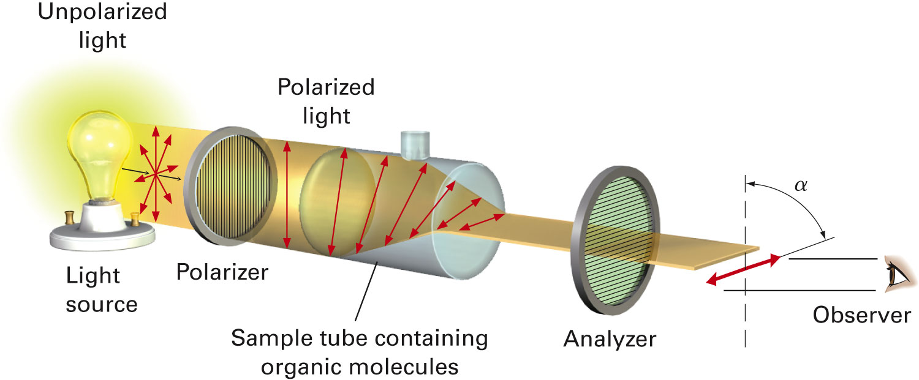
Figure 5.5 - Schematic Representation of a Polarimeter
Notes:
Optical activity

Slide 18
Specific Rotation [α]_{D}
Optical rotation of a chiral compound under standard conditions
Specific rotation is that observed for a sample concentration of 1 g/cm³ in solution in cell with a 10 cm path using light from sodium metal vapor (589.6 nm wavelength)
Notes:
Optical activity

Slide 19
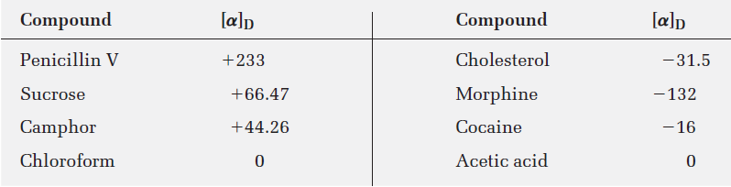
Table 5.1 - Specific Rotation of Some Organic Molecules
Notes:
Optical activity

Slide 20
Worked Example
A 1.50 g sample of coniine was dissolved in 10.0 mL of ethanol and placed in a sample cell with a 5.00 cm pathlength
The observed rotation at the sodium D line was 1.21°
Calculate [α]_{D} for coniine
Solution:
Given: l =5.00 cm = 0.500 dm; α = 1.21°;
C = 1.50g /10ml =0.150 g/mL
Notes:
Optical activity

Slide 21
Worked Example
Using the formula
Notes:
Optical activity

Slide 22
Pasteur’s Discovery of Enantiomers
Louis Pasteur discovered that sodium ammonium salts of tartaric acid crystallize into right handed and left handed forms
Equal concentrations of these forms have opposite optical rotations
Solutions contain mirror image isomers, called enantiomers, and they crystallized in mirror image shapes
Notes:
Pasteur’s discovery of enantiomers

Slide 23
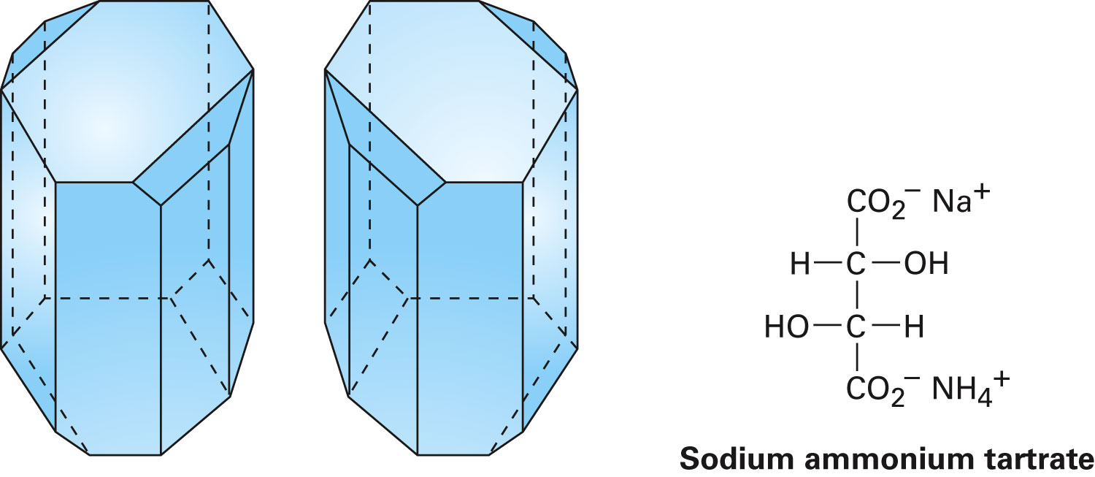
Figure 5.6 - Drawings of Sodium Ammonium Tartrate Crystals From Pasteur’s Original Sketches
Notes:
Pasteur’s discovery of enantiomers

Slide 24
Sequence Rules for Specifying Configuration
General method applies to the configuration at each chirality
Configuration is specified by the relative positions of all the groups with respect to each other at the chirality center
Groups are ranked and compared in an established priority sequence
Also called the Cahn–Ingold–Prelog rules
Notes:
Sequence rules for specifying configuration

Slide 25
Sequence Rules for Specifying Configuration
Rule 1
Look at the four atoms directly attached to the chirality center, and rank them according to atomic number
Atom with highest atomic number has highest ranking, and atom with lowest atomic number has lowest ranking
Notes:
Sequence rules for specifying configuration

Slide 26
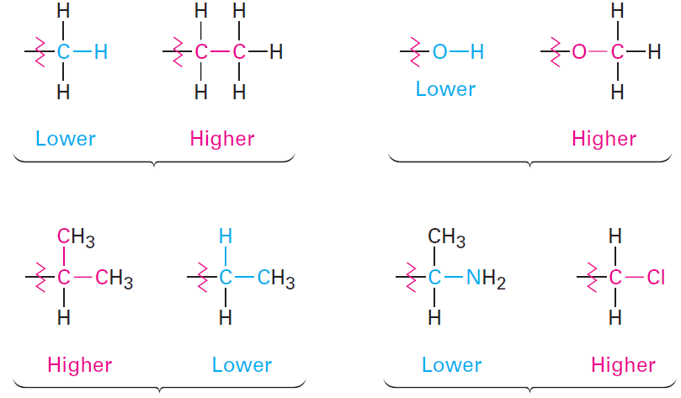
Sequence Rules for Specifying Configuration
Rule 2
If a decision cannot be reached by ranking the first atoms in the substituent, look at the second, third, or fourth atoms until the difference is found
Notes:
Sequence rules for specifying configuration

Slide 27
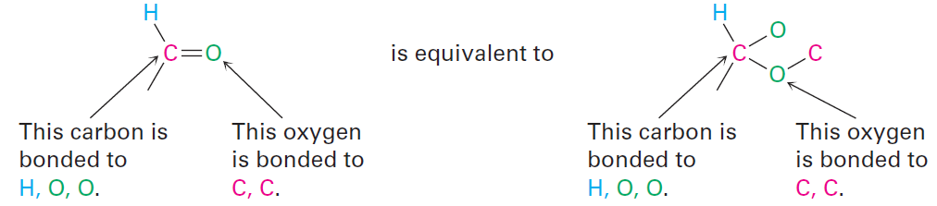
Sequence Rules for Specifying Configuration
Rule 3
Multiple-bonded atoms are equivalent to the same number of single-bonded atoms
Notes:
Sequence rules for specifying configuration

Slide 28
Sequence Rules for Specifying Configuration
R configuration: Configuration of chirality center if the curved arrow is drawn clockwise
S configuration: Configuration of chirality center if the curved arrow is drawn counterclockwise
Absolute configuration: Exact 3-D structure of a chiral molecule
Notes:
Sequence rules for specifying configuration

Slide 29
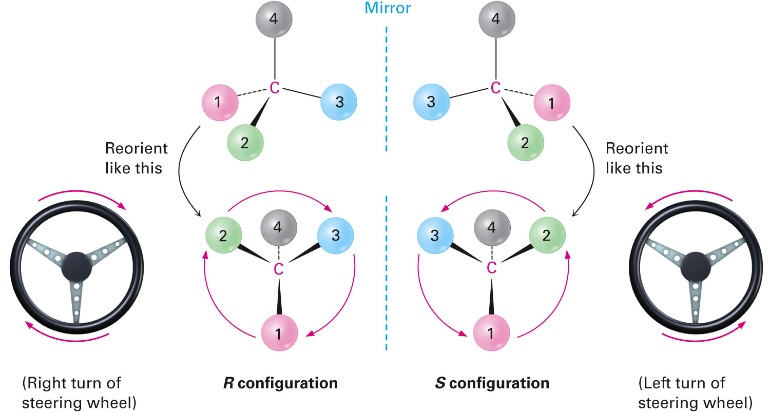
Figure 5.7 - Assigning Configuration to a Chirality Center
Notes:
Sequence rules for specifying configuration

Slide 30
Worked Example
Rank the following sets of substituents:
a) –H, –OH, –CH₂CH₃, –CH₂CH₂OH
b) –SH, –CH₂SCH₃, –CH₃, –SSCH₃
Solution:
Using the sequence rules:
a) –OH, –CH₂CH₂OH, –CH₂CH₃, –H
b) –SSCH₃, –SH, –CH₂SCH₃, –CH₃
Highest Lowest
Highest Lowest
Notes:
Sequence rules for specifying configuration

Slide 31
Diastereomers
Stereoisomers that are not mirror images
Molecules with more than one chirality center usually have mirror image stereoisomers that are not enantiomers
Epimers: Compounds in which two diastereomers differ at only one chirality center but are the same at all others
Notes:
Diastereomers

Slide 32
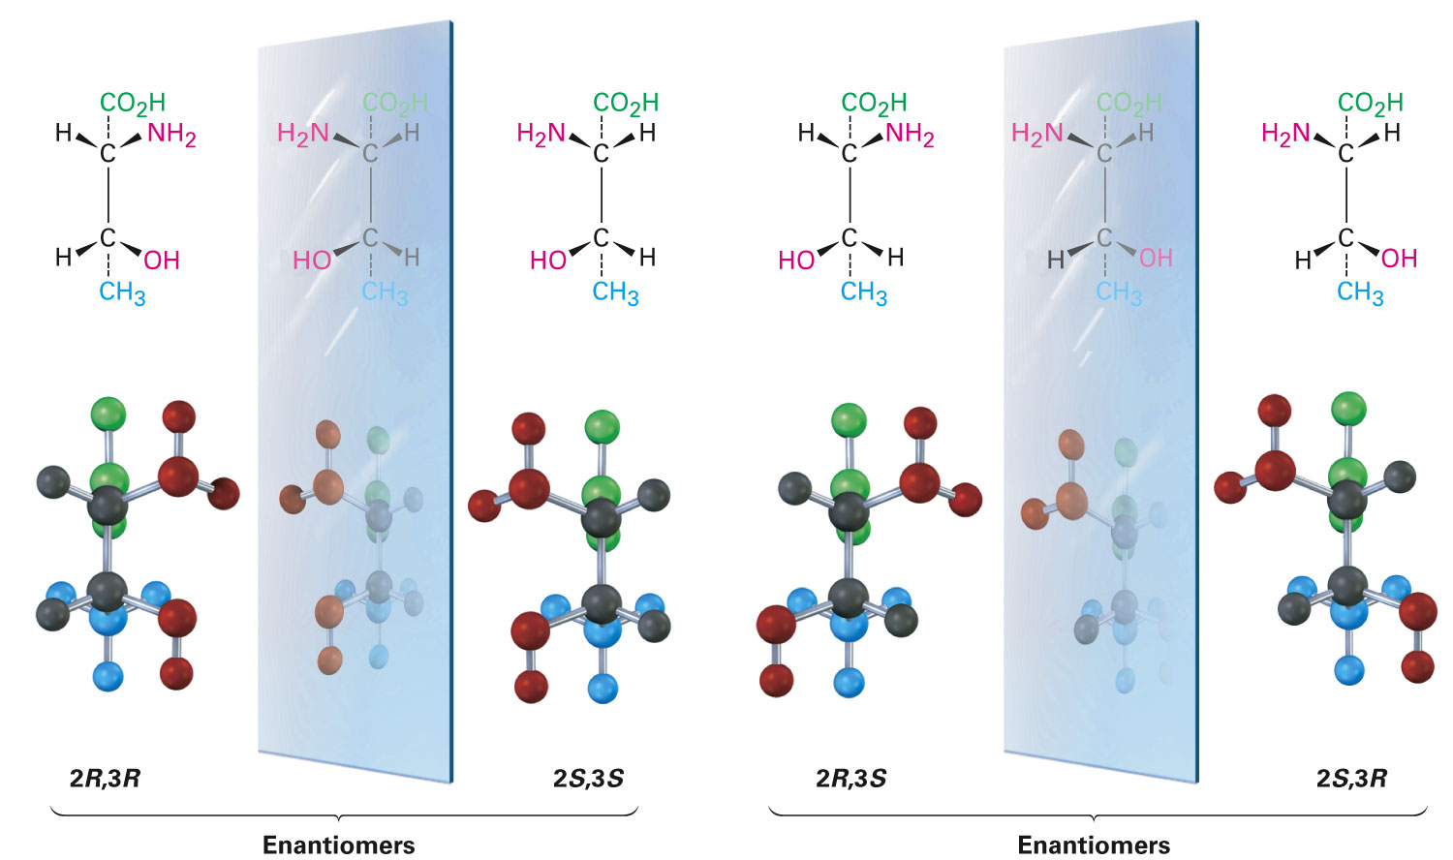
Figure 5.10 - The Four Stereoisomers of 2-amino-3-hydroxybutanoic Acid
Notes:
Diastereomers

Slide 33
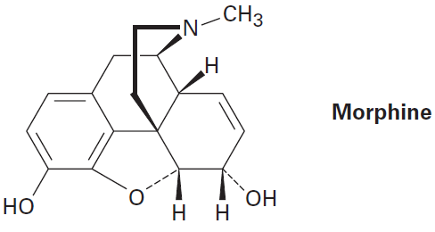
Worked Example
How many chirality centers does morphine have?
How many stereoisomers of morphine are possible in principle?
Notes:
Diastereomers

Slide 34
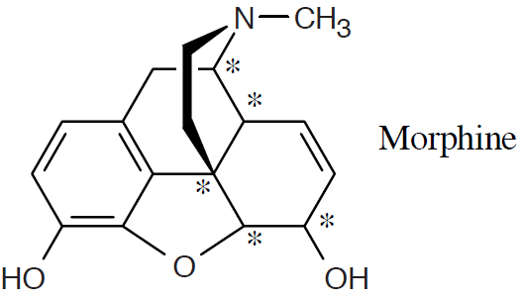
Worked Example
Solution:
Number of chirality centers = 5
Number of stereoisomers = 2^{n} = 2⁵ = 32
Majority of the stereoisomers are too strained to exist
Notes:
Diastereomers

Slide 35
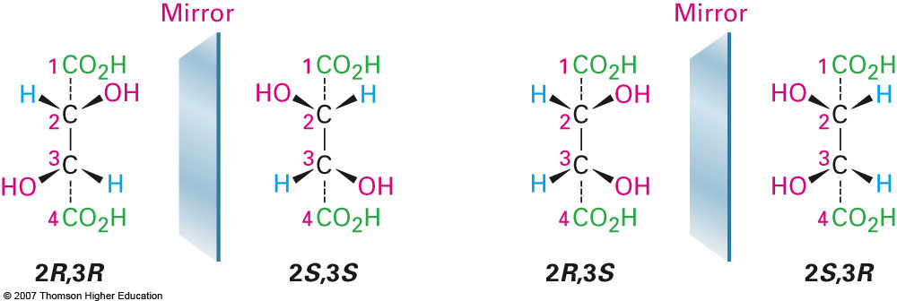
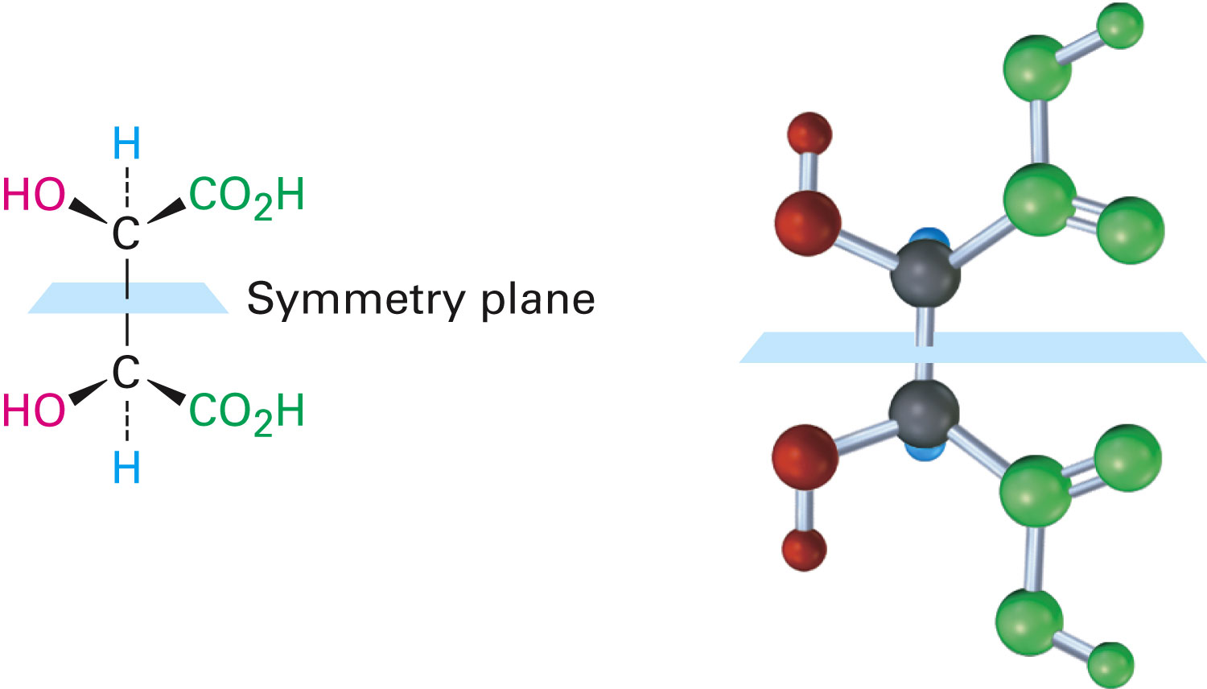
Meso Compounds
Achiral compounds with chirality centers
Tartaric acid has two chirality centers and two diastereomeric forms
One form is chiral and the other is achiral, but both have two chirality centers
Notes:
Meso compounds

Slide 36
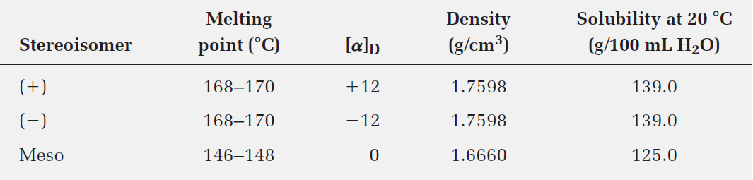
Table 5.3 - Some Properties of the Stereoisomers of Tartaric Acid
Notes:
Meso compounds

Slide 37
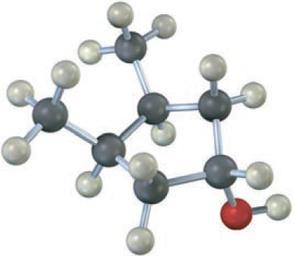
Worked Example
Does the following structure represent a meso compound?
If so, indicate the symmetry plane
Notes:
Meso compounds

Slide 38
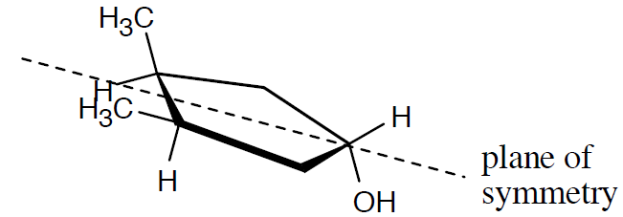
Worked Example
Solution:
The molecule represents a meso compound
The symmetry plane passes through the carbon bearing the –OH group and between the two ring carbons that are bonded to methyl groups
Notes:
Meso compounds

Slide 39
Racemic Mixtures and The Resolution of Enantiomers
Racemate: A 50:50 mixture of two chiral compounds that are mirror images do not exhibit optical rotation
Called a racemic mixture
Common method of resolution uses an acid–base reaction between the racemate of a chiral carboxylic acid and an amine base
Yields an ammonium salt
Notes:
Racemic mixtures and the resolution of enantiomers

Slide 40
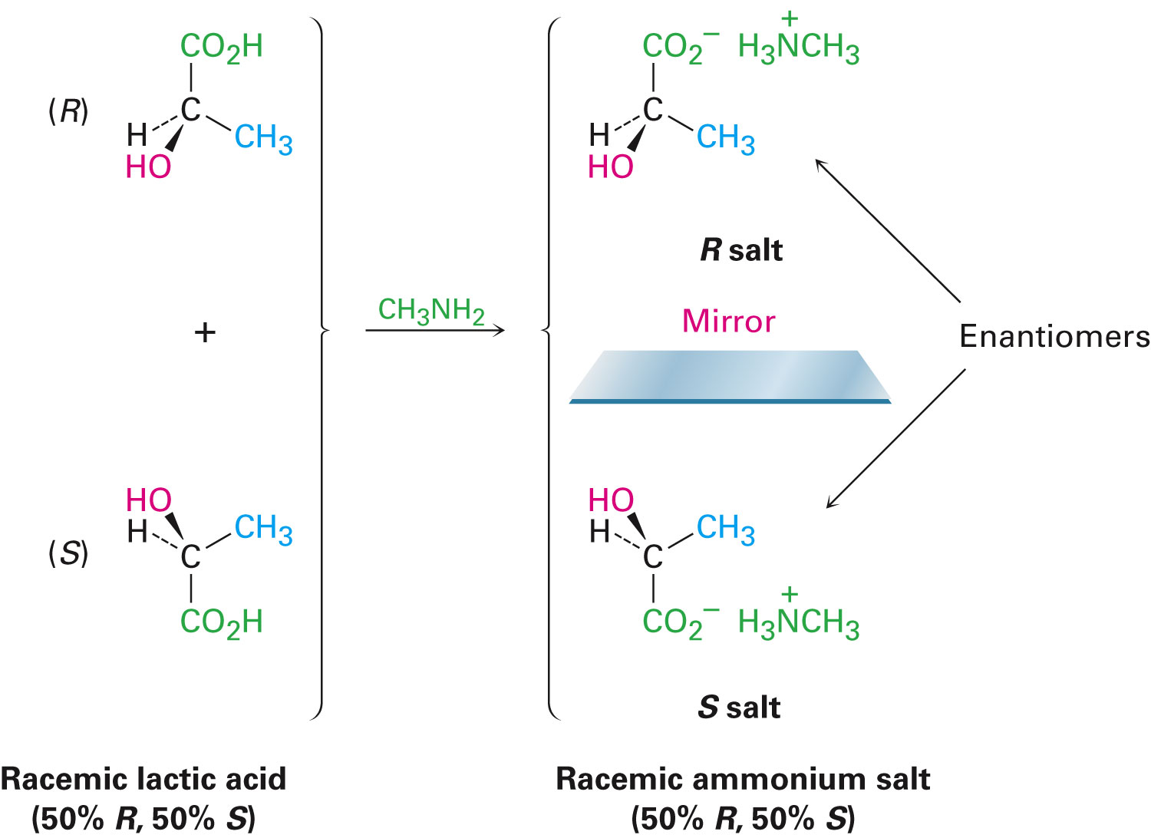
Figure 5.12 - Reaction of Racemic Lactic Acid with Achiral Methylamine
Notes:
Racemic mixtures and the resolution of enantiomers

Slide 41
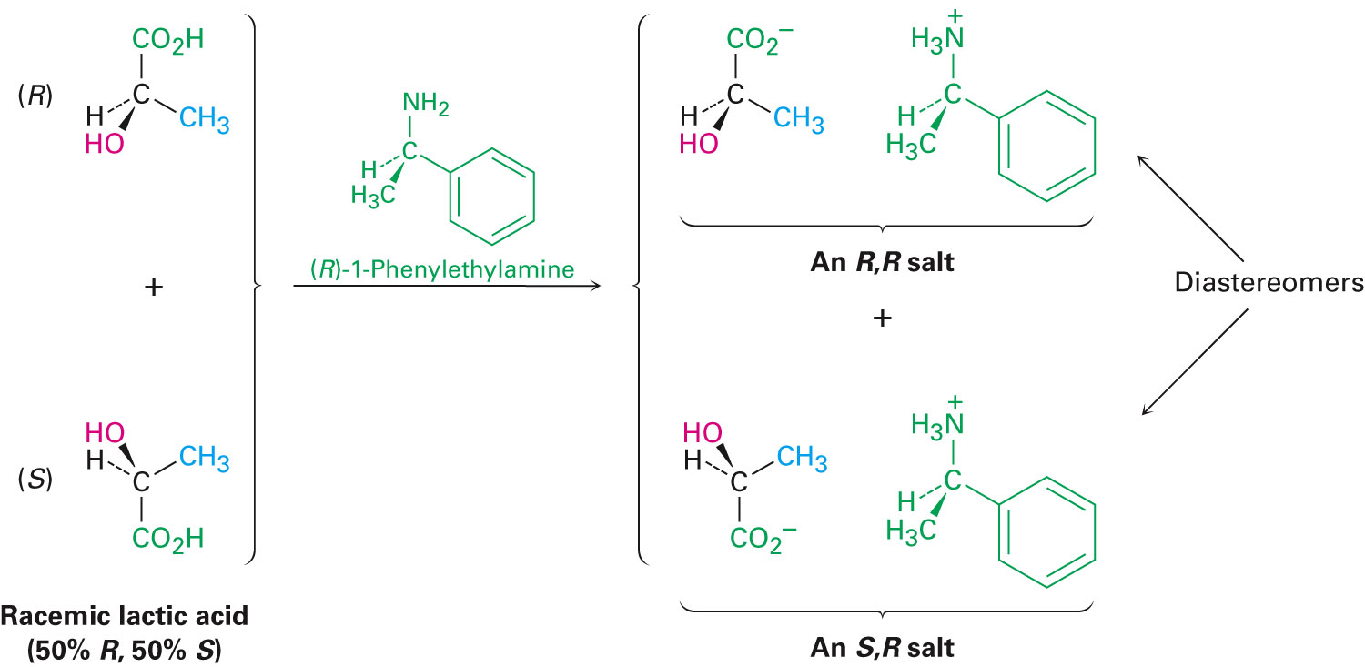
Figure 5.13 - Reaction of Racemic Lactic Acid with (R)-1-Phenylethylamine
Notes:
Racemic mixtures and the resolution of enantiomers

Slide 42
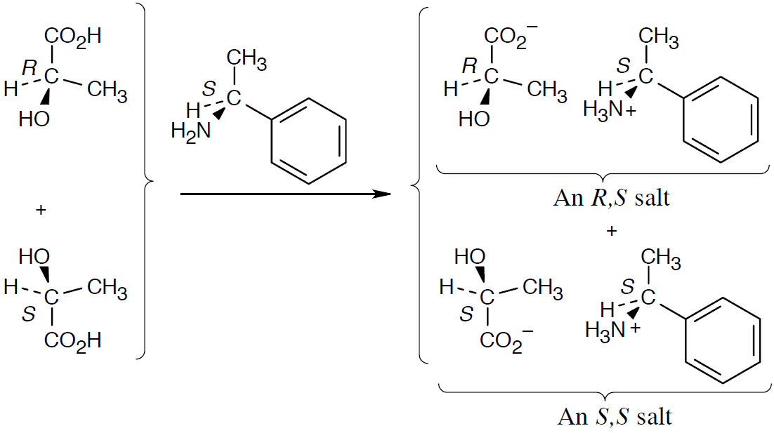
Worked Example
What stereoisomers would result from reaction of (6)-lactic acid with (S)-1-phenylethylamine?
Solution:
Notes:
Racemic mixtures and the resolution of enantiomers

Slide 43
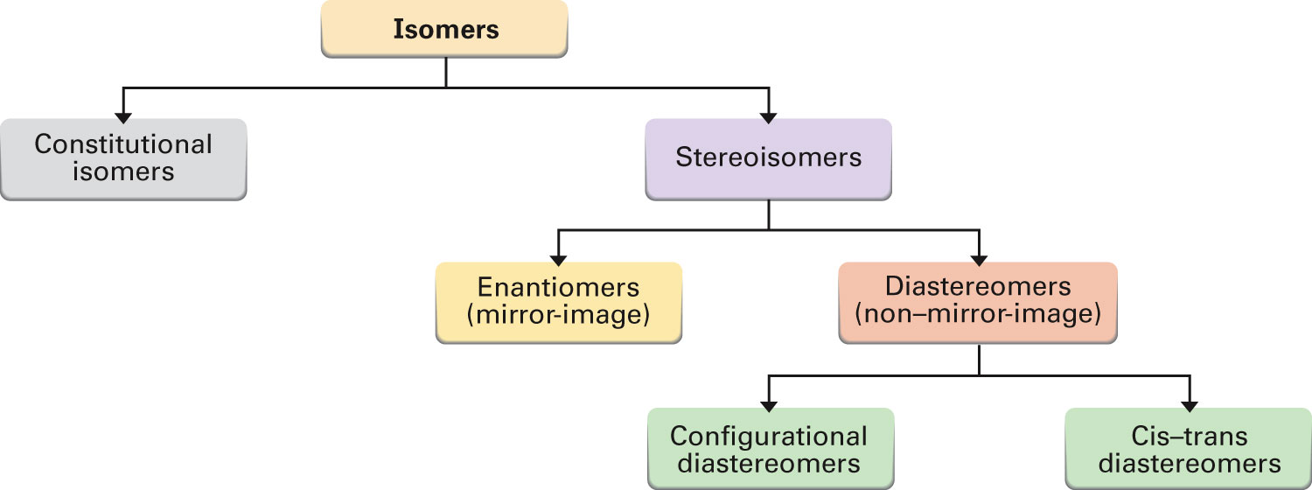
Figure 5.14 - A Summary of the Different Kinds of Isomers
Notes:
A review of isomerism

Slide 44
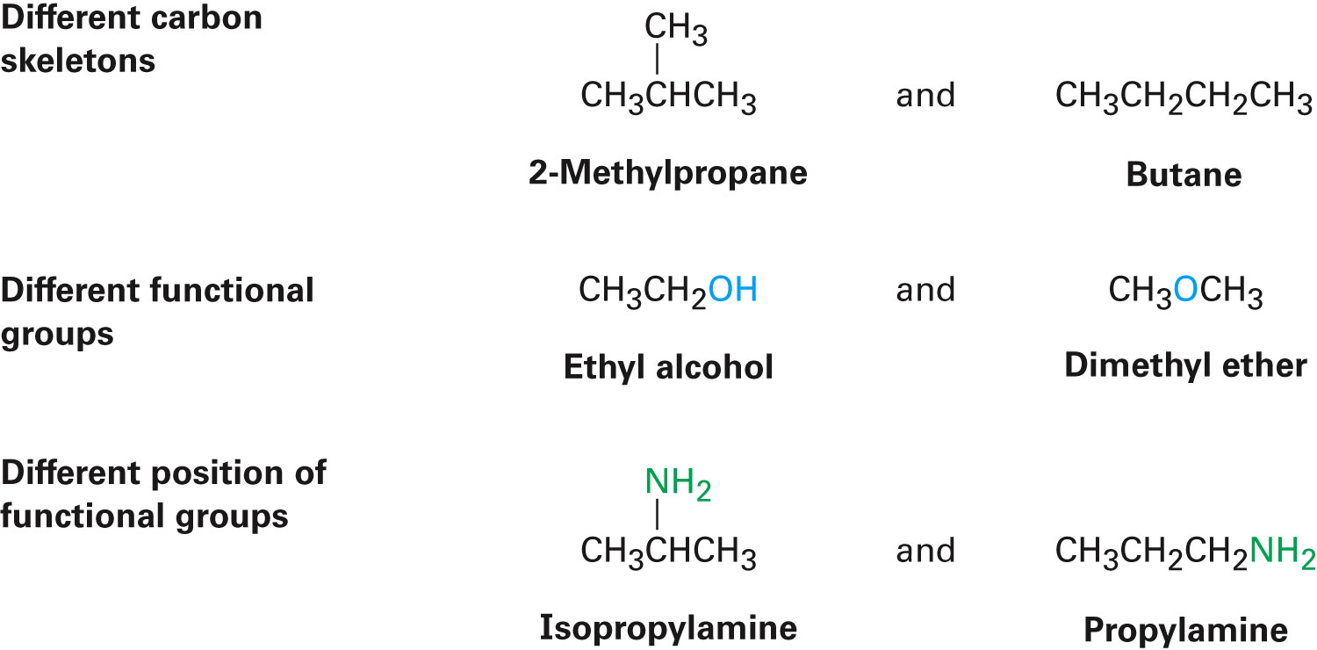
Constitutional Isomers
Compounds whose atoms are connected differently
Notes:
A review of isomerism

Slide 45
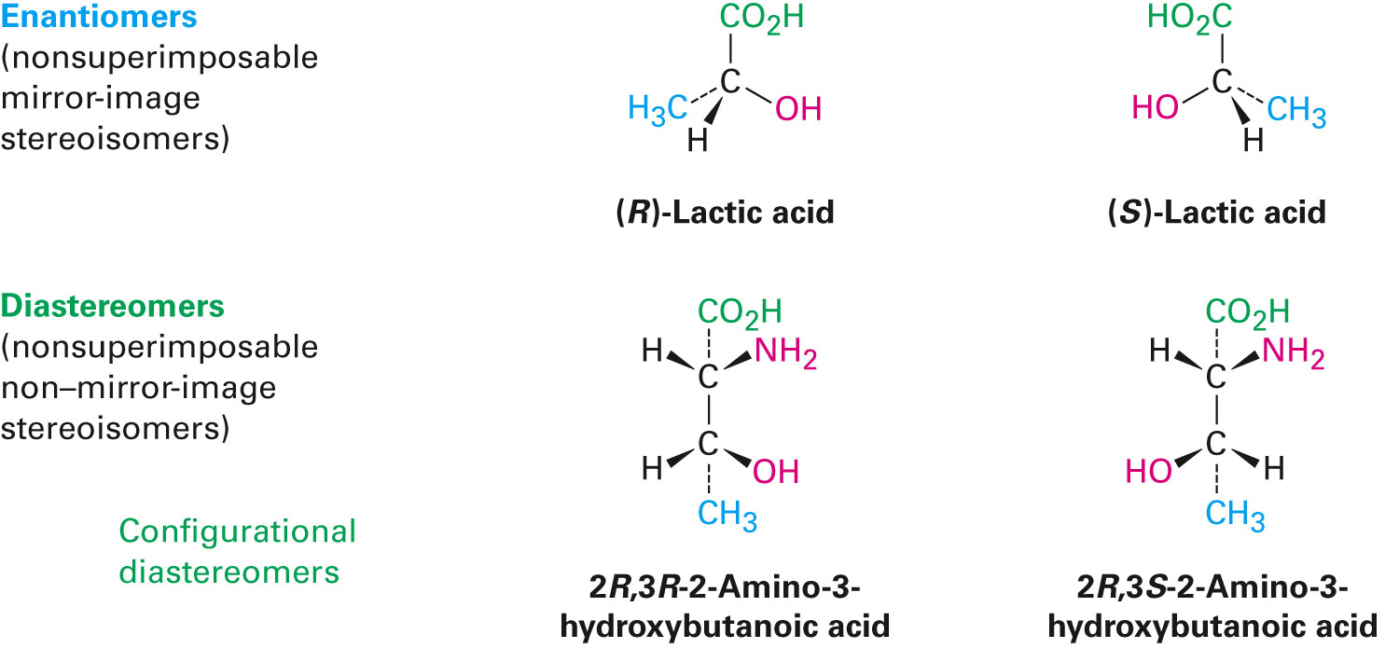
Stereoisomers
Same connections, different spatial arrangement of atoms
Enantiomers (nonsuperimposable mirror images)
Diastereomers (all other stereoisomers)
Includes cis, trans, and configurational
Notes:
A review of isomerism

Slide 46
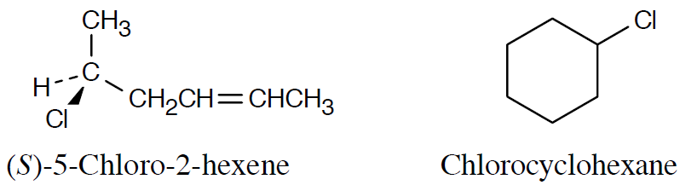
Worked Example
What kinds of isomers are the following pairs?
a) (S)-5-Chloro-2-hexene and chlorocyclohexane
b) (2R,3R)-Dibromopentane and (2S,3R)-dibromopentane
Solution:
a)
These two compounds are constitutional isomers
Notes:
A review of isomerism

Slide 47
Worked Example
b) The two dibromopentane stereoisomers are diastereomers
Notes:
A review of isomerism

Slide 48
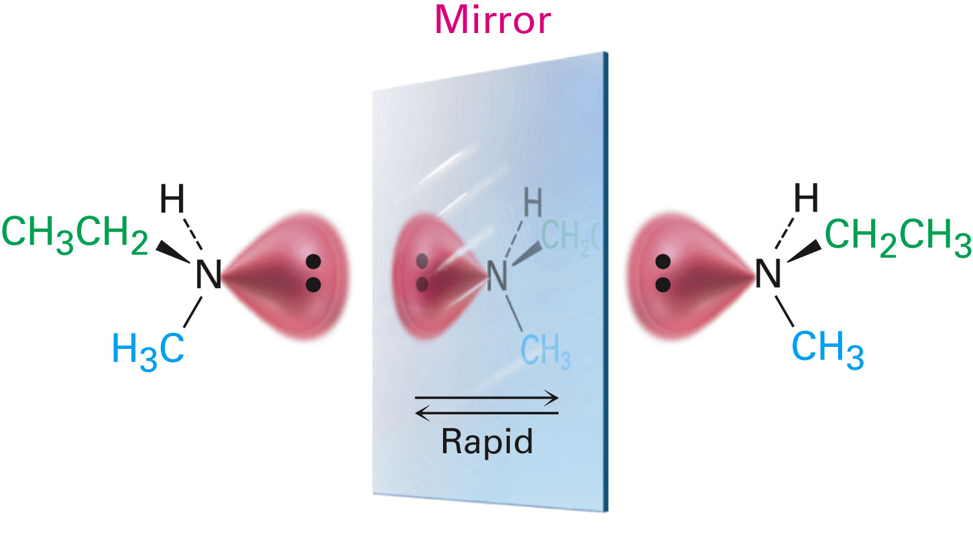
Chirality at Nitrogen, Phosphorus, and Sulfur
N, P, and S are commonly found in organic compounds and can have chirality centers
Trivalent nitrogen is tetrahedral
Does not form a chirality center since it rapidly flips
Individual enantiomers cannot be isolated
Notes:
Chirality at nitrogen, phosphorus, and sulfur

Slide 49
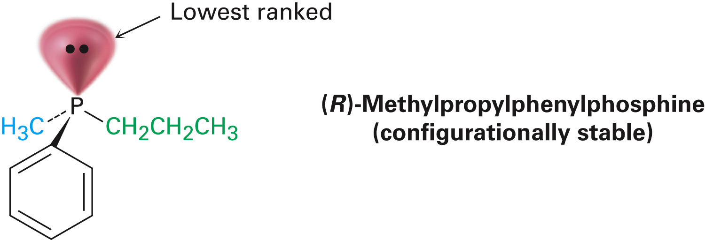
Chirality at Nitrogen, Phosphorus, and Sulfur
May apply to phosphorus but it flips slowly
Notes:
Chirality at nitrogen, phosphorus, and sulfur

Slide 50
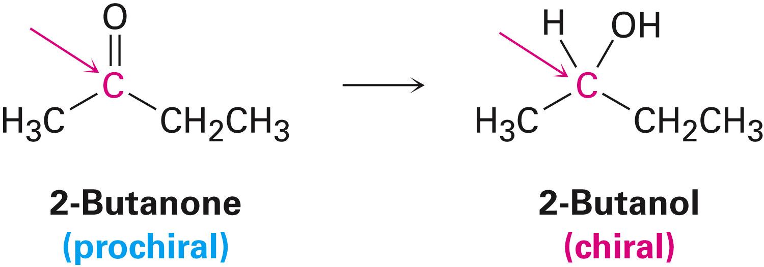
Prochirality
A prochiral molecule is a molecule that is achiral but can become chiral by a single alteration
Re face: Face on which the arrows curve clockwise
Si face: Face on which the arrows curve counterclockwise
Notes:
Prochirality

Slide 51
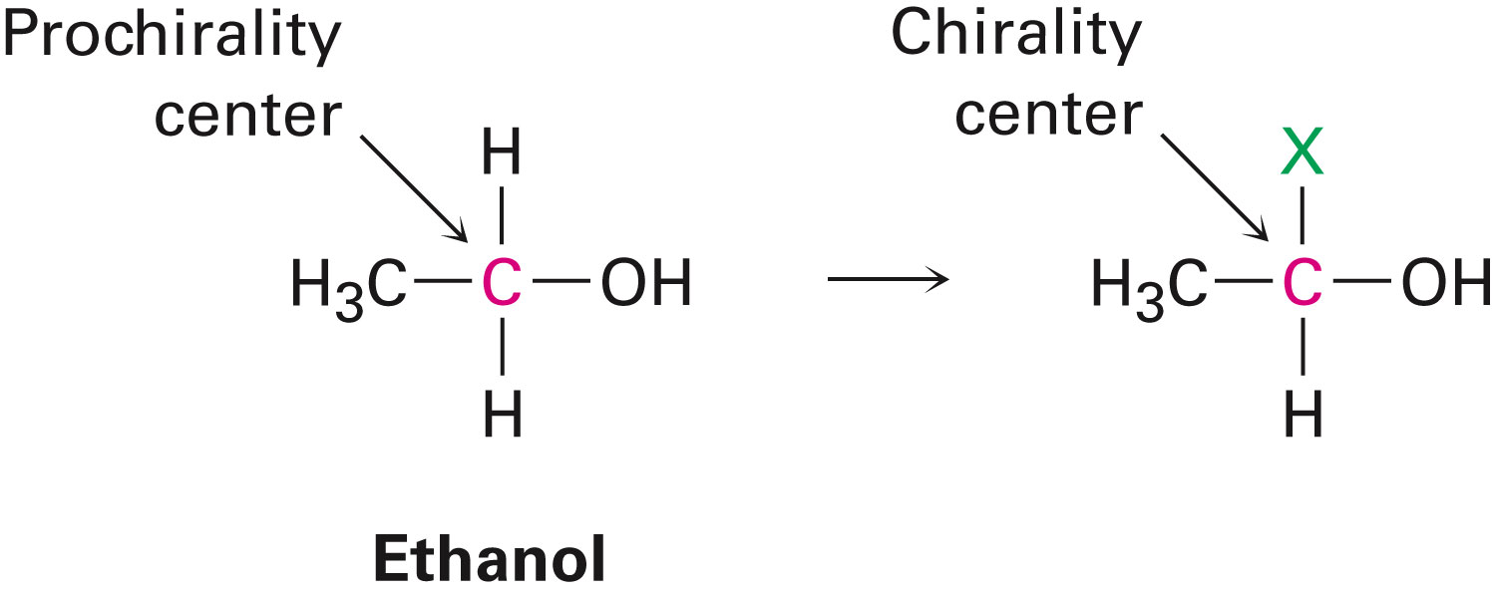
Prochirality
Planar faces that can become tetrahedral are different from the top or bottom
Prochirality center: Atom in a compound that can be converted into a chirality center by changing one of its attached substituents
Notes:
Prochirality

Slide 52
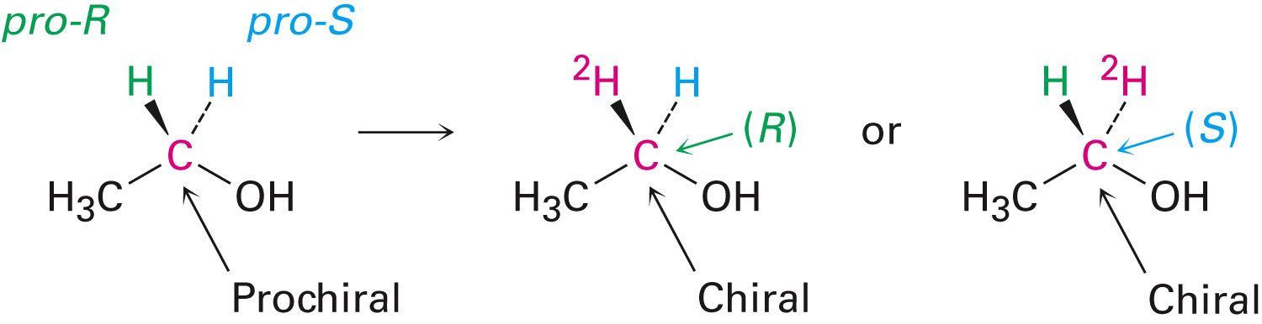
Prochirality
An sp³ carbon with two groups that are the same is a prochirality center
Two identical groups are distinguished by considering either and seeing if it were increased in priority in comparison with the other
If the center becomes R, the group is pro-R and if the center becomes S, the group is pro-S
Notes:
Prochirality

Slide 53
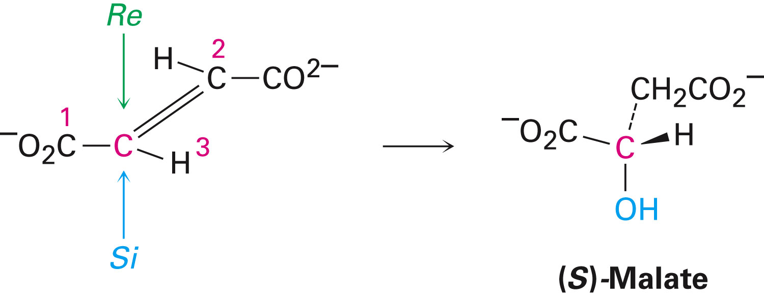
Prochirality
Biological reactions often involve prochiral compounds
Determining the stereochemistry of reactions at prochirality centers helps in the study of mechanisms in biochemical reactions
Example - Addition of water to fumarate
Notes:
Prochirality

Slide 54
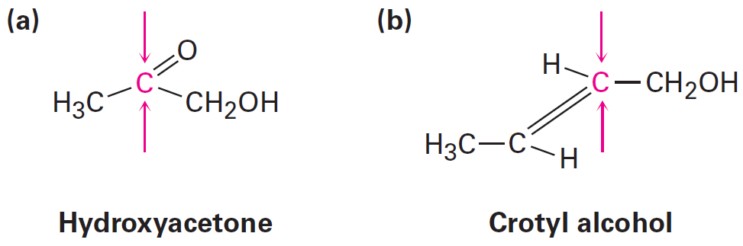
Worked Example
Identify the indicated faces of carbon atoms in the following molecules as Re or Si:
Notes:
Prochirality

Slide 55
Worked Example
Solution:
Draw the plane that includes the sp² carbon and its substituents, and rank the substituents
The arrow that proceeds from group 1 to group 2 to group 3 is drawn
If the direction of rotation is clockwise, the face is the Re face
If rotation is counterclockwise, the face is the Si face
Notes:
Prochirality

Slide 56
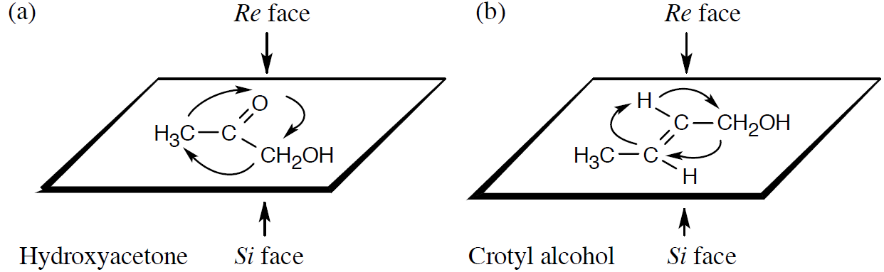
Worked Example
Notes:
Prochirality

Slide 57
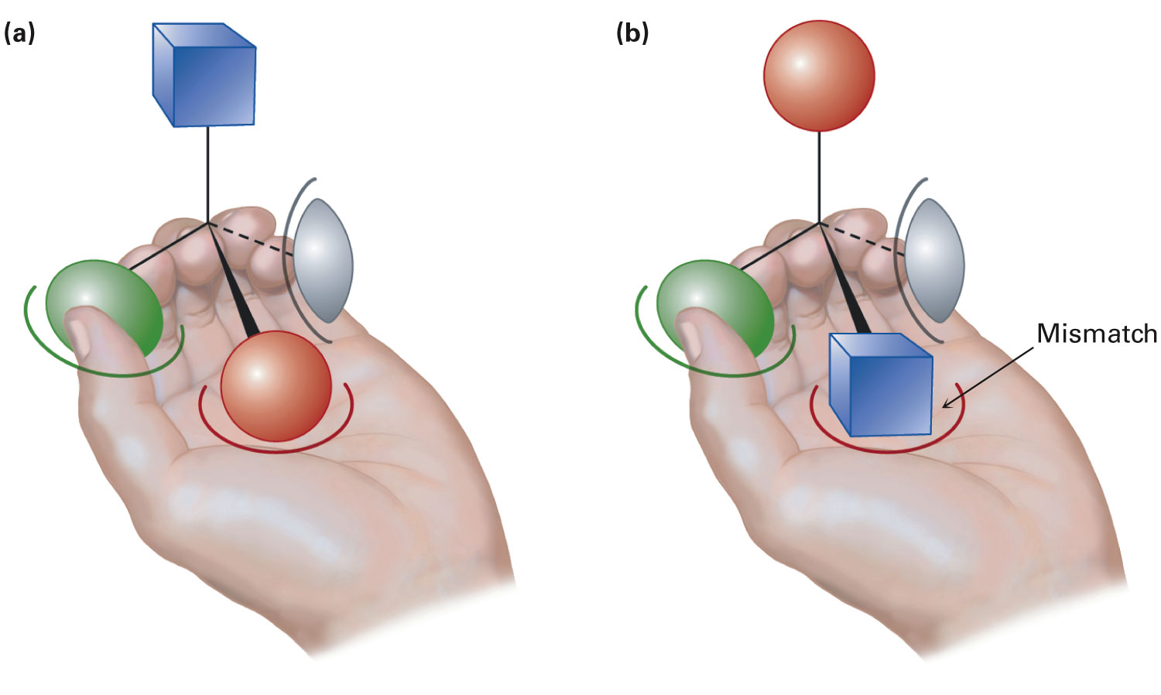
Chirality in Nature and Chiral Environments
Stereoisomers are readily distinguished by chiral receptors in nature
Properties of drugs depend on stereochemistry
Notes:
Chirality in nature and chiral environments

Slide 58
Summary
Objects or molecules that are not superimposable on its mirror image are said to be chiral
Common cause of chirality in organic molecules is the presence of the chirality center
Chiral compounds can exist as a pair of nonsuperimposable mirror-image stereoisomers called enantiomers

Slide 59
Summary
Stereochemical configuration of a chirality center can be specified as either R or S by using the Cahn–Ingold–Prelog rules
Diastereomers have the same configuration in at least one center and opposite configurations at the others
Epimers are diastereomers that differ in configuration at only one chirality center

Slide 60
Summary
Meso compounds contain chirality centers but are achiral
50:50 mixtures of (+) and (-) enantiomers area called racemates
If a molecule can be achiral to chiral in a single chemical step, it is said to be prochiral
Prochiral sp²-hybridized atom has two faces, described as either Re or Si

Slide 61
Summary
An sp³-hybridized atom is a prochirality center if, by changing one of its attached atoms results in a chirality center
Atom whose replacement leads to an R chirality center is pro-R
Atom whose replacement leads to an S chirality center is pro-S

